Slide 1
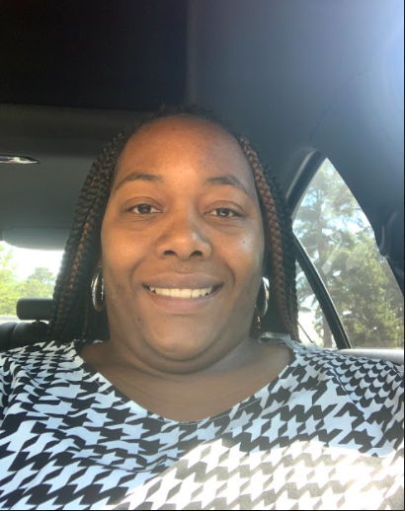
Ms. Harvey 5th Grade Math & Science

Slide 2
My Contact Information
Email: HarveJa1@boe.Richmond.k12.ga.us
Remind: Text the message @msharvey5 to the number 81010.
Google Voice: 762-233-1211
School Number: 706-737-7288
*** Please remember to sign up for Class Dojo!

Slide 4
CHECKOUT MY WEBSITE TO VIEW THE FOLLOWING INFORMATION
Week At A Glance (WAG)
Class Syllabus/Supply List
Resources
Additional Information

Slide 5
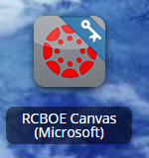
RCSS Learning Platform and Canvas
New to the Richmond County
Go to rcboe.org
Click Student
Click Launch Pad
Watch logging into Canvas as a student.
https://rcboe.instructuremedia.com/embed/048204ea-777e-4c04-9fc0-357111372c96
Your child will login through Launch Pad to access RCBOE Canvas.
Click link to watch Tutorial Video
https://www.rcboe.org/Domain/16265

